Slide 1
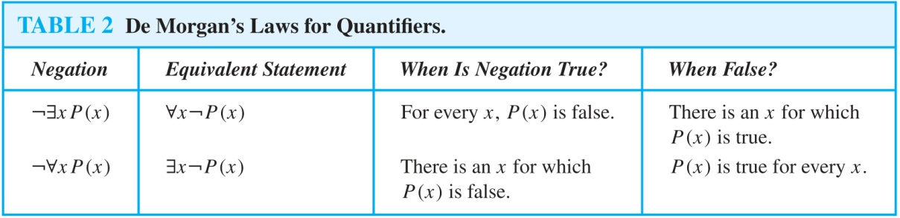
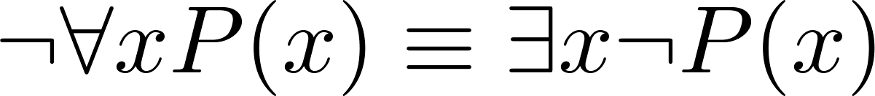
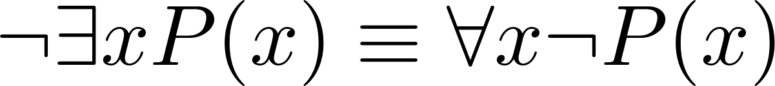
De Morgan’s Laws for Quantifiers
The rules for negating quantifiers are:
The reasoning in the table shows that:
These are important. You will use these.

Slide 2
Translation from English to Logic
Examples:
“Some student in this class has visited Mexico.”
Solution: Let M(x) denote “x has visited Mexico” and S(x) denote “x is a student in this class,” and U be all people.
∃x (S(x) ∧ M(x))
“Every student in this class has visited Canada or Mexico.”
Solution: Add C(x) denoting “x has visited Canada.”
and U be all people.
∀x (S(x)→ (M(x)∨C(x)))

Slide 3
Some Fun with Translating from English into Logical Expressions
U = {Nitwits, Blubbers, Oddments}
F(x): x is a Nitwit
S(x): x is a Blubber
T(x): x is a Oddment
Translate “Everything is a Nitwit”
Solution: ∀x F(x)

Slide 4
Translation (cont)
U = {Nitwits, Blubbers, Oddments}
F(x): x is a Nitwit
S(x): x is a Blubber
T(x): x is a Oddment
“Nothing is a Blubber.”
Solution: ¬∃x S(x) What is this equivalent to?
Solution: ∀x ¬ S(x)

Slide 5
Translation (cont)
U = {Nitwits, Blubbers, Oddments}
F(x): x is a Nitwit
S(x): x is a Blubber
T(x): x is a Oddment
“All Nitwits are Blubbers.”
Solution: ∀x (F(x)→ S(x))

Slide 6
Translation (cont)
U = {Nitwits, Blubbers, Oddments}
F(x): x is a Nitwit
S(x): x is a Blubber
T(x): x is a Oddment
“Some Nitwits are Oddments.”
Solution: ∃x (F(x) ∧ T(x))

Slide 7
Translation (cont)
U = {Nitwits, Blubbers, Oddments}
F(x): x is a Nitwit
S(x): x is a Blubber
T(x): x is a Oddment
“No Blubber is a Oddment.”
Solution: ¬∃x (S(x) ∧ T(x)) What is this equivalent to?
Solution: ∀x ¬ (S(x) ∧ T(x))
∀x (¬S(x) ∨ ¬T(x))

Slide 8
Translation (cont)
U = {Nitwits, Blubbers, Oddments}
F(x): x is a Nitwit
S(x): x is a Blubber
T(x): x is a Oddment
“If any Nitwit is a Blubber then it is also a Oddment.”
Solution: ∀x ((F(x) ∧ S(x))→ T(x))

Slide 9
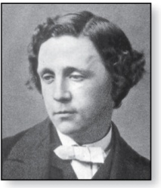
Lewis Carroll Example
Charles Lutwidge Dodgson
(AKA Lewis Caroll)
(1832-1898)
The first two are called premises and the third is called the conclusion.
“All lions are fierce.”
“Some lions do not drink coffee.”
“Some fierce creatures do not drink coffee.”
Here is one way to translate these statements to predicate logic. Let P(x), Q(x), and R(x) be the propositional functions “x is a lion,” “x is fierce,” and “x drinks coffee,” respectively.
∀x (P(x)→ Q(x))
∃x (P(x) ∧ ¬R(x))
∃x (Q(x) ∧ ¬R(x))
Later we will see how to prove that the conclusion follows from the premises.

Slide 10
Nested Quantifiers
Section 1.5

Slide 11
Section Summary
Nested Quantifiers
Order of Quantifiers
Translating from Nested Quantifiers into English
Translating Mathematical Statements into Statements involving Nested Quantifiers.
Translated English Sentences into Logical Expressions.
Negating Nested Quantifiers.

Slide 12
Nested Quantifiers
Nested quantifiers are often necessary to express the meaning of sentences in English as well as important concepts in computer science and mathematics.
Example: “Every real number has an inverse” is
∀x ∃y(x + y = 0)
where the domains of x and y are the real numbers.
We can also think of nested propositional functions:
∀x ∃y(x + y = 0) can be viewed as ∀x Q(x) where Q(x) is ∃y P(x, y) where P(x, y) is (x + y = 0)

Slide 13
Thinking of Nested Quantification
Nested Loops
To see if ∀x∀yP (x,y) is true, loop through the values of x :
At each step, loop through the values for y.
If for some pair of x andy, P(x,y) is false, then ∀x ∀yP(x,y) is false and both the outer and inner loop terminate.
∀x ∀y P(x,y) is true if the outer loop ends after stepping through each x.
To see if ∀x ∃yP(x,y) is true, loop through the values of x:
At each step, loop through the values for y.
The inner loop ends when a pair x and y is found such that P(x, y) is true.
If no y is found such that P(x, y) is true the outer loop terminates as ∀x ∃yP(x,y) has been shown to be false.
∀x ∃y P(x,y) is true if the outer loop ends after stepping through each x.
If the domains of the variables are infinite, then this process can not actually be carried out.

Slide 14
Order of Quantifiers
Examples:
Let P(x,y) be the statement “x + y = y + x.” Assume that U is the real numbers. Then ∀x ∀yP(x,y) and∀y ∀xP(x,y) have the same truth value.
Let Q(x,y) be the statement “x + y = 0.” Assume that U is the real numbers. Then ∀x ∃yP(x,y) is true, but ∃y ∀xP(x,y) is false.
This is for all real numbers, there is a real number such that x+y = 0

Slide 15
Questions on Order of Quantifiers
Example 1: Let U be the real numbers,
Define P(x,y) : x ∙ y = 0
What is the truth value of the following:
∀x∀yP(x,y)
Answer: False
∀x∃yP(x,y)
Answer: True
∃x∀y P(x,y)
Answer: False
∃x ∃ y P(x,y)
Answer: True

Slide 16
Questions on Order of Quantifiers
Example 2: Let U be the real numbers,
Define P(x,y) : x / y = 1
What is the truth value of the following:
∀x∀yP(x,y)
Answer: False
∀x∃yP(x,y)
Answer: True
∃x∀y P(x,y)
Answer: False
∃x ∃ y P(x,y)
Answer: True

Slide 17
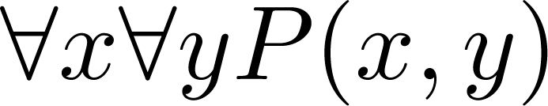
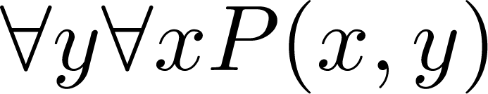
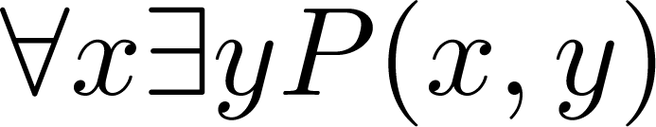
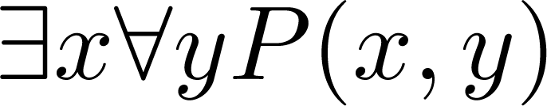
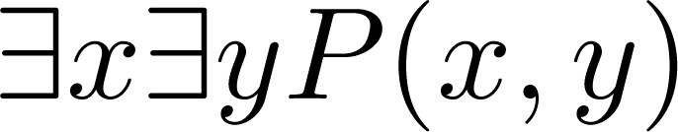
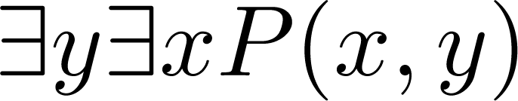
Quantifications of Two Variables
Statement | When True? | When False
 | P(x,y) is true for every pair x,y. | There is a pair x, y for which P(x,y) is false.
 | For every x there is a y for which P(x,y) is true. | There is an x such that P(x,y) is false for every y.
 | There is an x for which P(x,y) is true for every y. | For every x there is a y for which P(x,y) is false.
 | There is a pair x, y for which P(x,y) is true. | P(x,y) is false for every pair x,y

Slide 18
Translating Nested Quantifiers into English
Example 1: Translate the statement
∀x (C(x )∨ ∃y (C(y ) ∧ F(x, y)))
where C(x) is “x has a computer,” and F(x,y) is “x and y are friends,” and the domain for both x and y consists of all students in your school.
Solution: Every student in your school has a computer or has a friend who has a computer.

Slide 19
Translating Mathematical Statements into Predicate Logic
Example : Translate “The sum of two positive integers is always positive” into a logical expression.
Solution:
Rewrite the statement to make the implied quantifiers and domains explicit:
“For every two integers, if these integers are both positive, then the sum of these integers is positive.”
Introduce the variables x and y, and specify the domain, to obtain:
“For all positive integers x and y, x + y is positive.”
The result is:
∀x ∀ y ((x > 0)∧ (y > 0)→ (x + y > 0))
where the domain of both variables consists of all integers

Slide 20
Translating English into Logical Expressions Example
Example: Use quantifiers to express the statement “There is a woman who has taken a flight on every airline in the world.”
Solution:
Let P(w,f) be “w has taken f ” and Q(f,a) be “f is a flight on a .”
The domain of w is all women, the domain of f is all flights, and the domain of a is all airlines.
Then the statement can be expressed as:
∃w ∃f ∀a (P(w,f ) ∧ Q(f,a))

Slide 21
Questions on Translation from English
Choose the obvious predicates and express in predicate logic.
Example 1: “Brothers are siblings.”
Solution: ∀x ∀y (B(x,y) → S(x,y))
Example 2: “Siblinghood is symmetric.”
Solution: ∀x ∀y (S(x,y) → S(y,x))
Example 3: “Everybody loves somebody.”
Solution: ∀x ∃y L(x,y)
Example 4: “There is someone who is loved by everyone.”
Solution: ∃y ∀x L(x,y)
Example 5: “There is someone who loves someone.”
Solution: ∃x ∃y L(x,y)
Example 6: “Everyone loves himself”
Solution: ∀x L(x,x)

Slide 22
Negating Nested Quantifiers
Example 1: Recall the logical expression developed three slides back:
∃w ∀a ∃f (P(w,f ) ∧ Q(f,a))
Part 1: Use quantifiers to express the statement that “There does not exist a woman who has taken a flight on every airline in the world.”
Solution: ¬∃w ∀a ∃f (P(w,f ) ∧ Q(f,a))
Part 2: Now use De Morgan’s Laws to move the negation as far inwards as possible.
Solution:
¬∃w ∀a ∃f (P(w,f ) ∧ Q(f,a))
∀w ¬ ∀a ∃f (P(w,f ) ∧ Q(f,a)) by De Morgan’s for ∃
∀w ∃ a ¬ ∃f (P(w,f ) ∧ Q(f,a)) by De Morgan’s for ∀
∀w ∃ a ∀f ¬ (P(w,f ) ∧ Q(f,a)) by De Morgan’s for ∃
∀w ∃ a ∀f (¬ P(w,f ) ∨ ¬ Q(f,a)) by De Morgan’s for ∧.
Part 3: Can you translate the result back into English?
Solution:
“For every woman there is an airline such that for all flights, this woman has not taken that flight or that flight is not on this airline”

Slide 23
Some Questions about Quantifiers
Can you switch the order of quantifiers?
Is this a valid equivalence?
Solution: Yes! The left and the right side will always have the same truth value. The order in which x and y are picked does not matter.
Is this a valid equivalence?
Solution: No! The left and the right side may have different truth values for some propositional functions for P. Try “x + y = 0” for P(x,y) with U being the integers. The order in which the values of x and y are picked does matter.
Can you distribute quantifiers over logical connectives?
Is this a valid equivalence?
Solution: Yes! The left and the right side will always have the same truth value no matter what propositional functions are denoted by P(x) and Q(x).
Is this a valid equivalence?
Solution: No! The left and the right side may have different truth values. Pick “x is a fish” for P(x) and “x has scales” for Q(x) with the domain of discourse being all animals. Then the left side is false, because there are some fish that do not have scales. But the right side is true since not all animals are fish.

